Slide 1
Modulação para Conversores Estáticos
Prof. Humberto Pinheiro, Ph.D.
GEPOC -UFSM

Slide 2
Conteúdo
Introdução
Modulação PWM com portadora
Modulação com Abordagem Geométrica
Modulação Vetorial – Space Vector
Modulação Síncrona Ótima
Modulação para o BLDC

Slide 3
Conteúdo
Introdução
Conversores estáticos e tecnologia de semicondutores
Perdas de condução e comutação
Taxa de distorção harmônicas e fatores de distorção
Aplicativos computacionais para simulação
Modulação PWM com portadora
Integral dupla de Fourier
Cancelamento de harmônicos em conversores estáticos
Modulação por deslocamento horizontal de portadoras ( phase shifted )
Modulação por deslocamento vertical de portadoras ( phase disposition )
Exemplos

Slide 4
Conteúdo
Modulação com Abordagem Geométrica
Introdução
Conversor em ponte completa monofásico
Conversor PWM trifásico
Conversores trifásicos de três níveis, NPC, T-type, FC.
Controle da tensão do ponto central do divisor capacitivo NPC
Conversor intercalado trifásico e controle do fluxo do indutor de interface
Modulação Vetorial – Space Vector
Introdução
Conversor monofásico em ponte completa
Conversor NPC e o conceito de vetores virtuais
Método do vetores espaciais inteiros ( 1D, 2D, 3D )
Sobre Modulação
Exemplos.

Slide 5
Conteúdo
Modulação Síncrona Ótima
Introdução
Espectro de funções com Simetria
Caso conversor monofásico ponte completa
Caso conversor trifásico completa
Formulação como um problema de otimização
Exemplos
Modulação para o BLDC
Modos de Operação
Padrões de PWM
Estimação da FCEM
Exemplo

Slide 6
Bibliografia
Pulse Width Modulation for Power Converters Principles and Pactice, D.Graname Holmes and Thomas A. Lipo, 1st Edition, IEEE Press, 2003.
Pulse Width Modulation, by Satish Kumar Peddapelli, ISBN: 9783110468571,2016.
Papers of IEEE TPE,TIA,TIE
Apostila do Prof. Humberto

Slide 7
Introdução
Conversores estáticos e tecnologia de semicondutores
Perdas de condução e comutação
Taxa de distorção harmônicas e fatores de distorção
Aplicativos computacionais para simulação

Slide 13
*

Slide 14
*

Slide 17
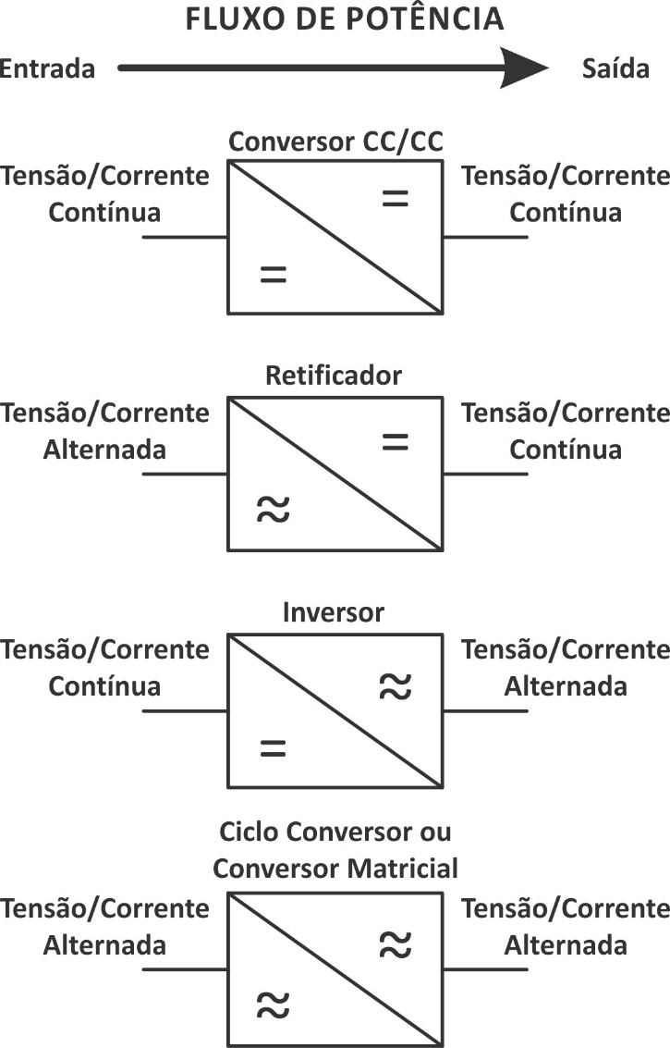

Slide 18
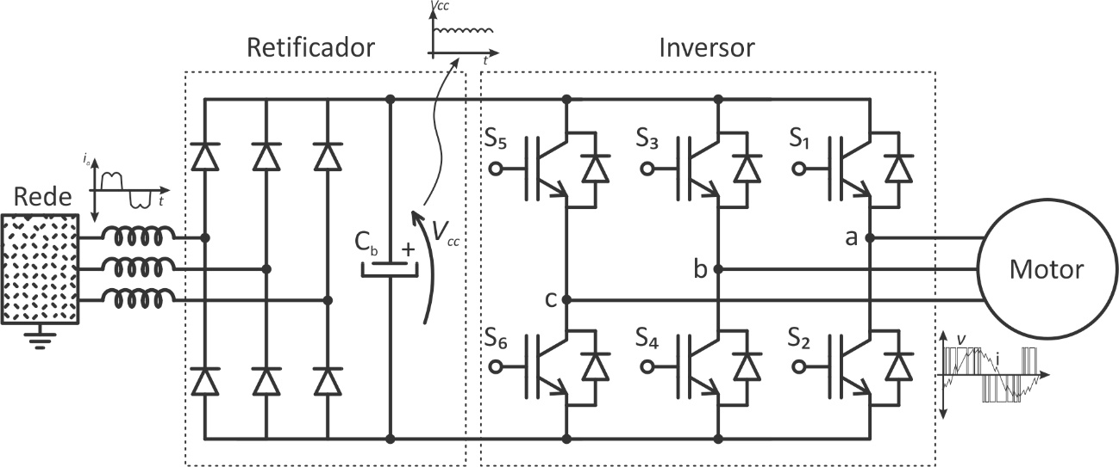

Slide 19
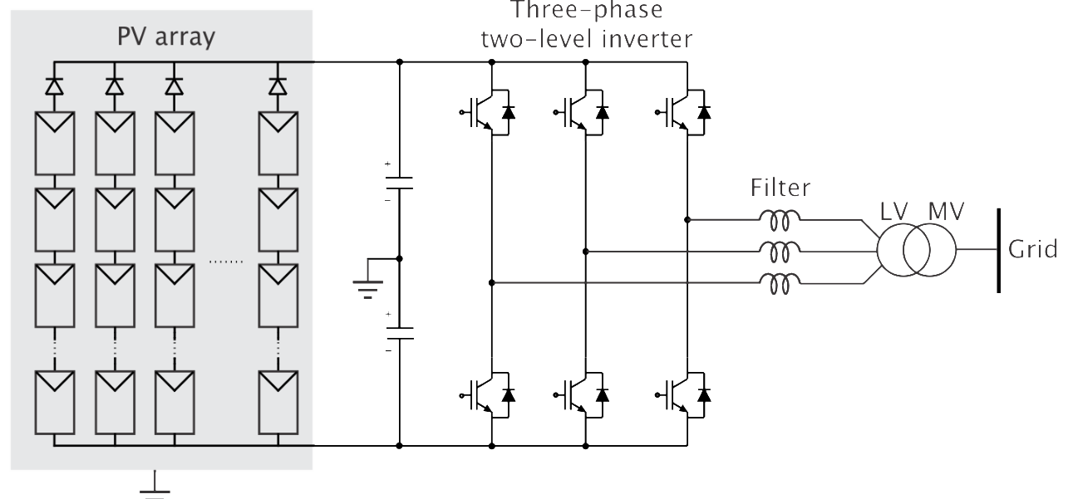

Slide 20
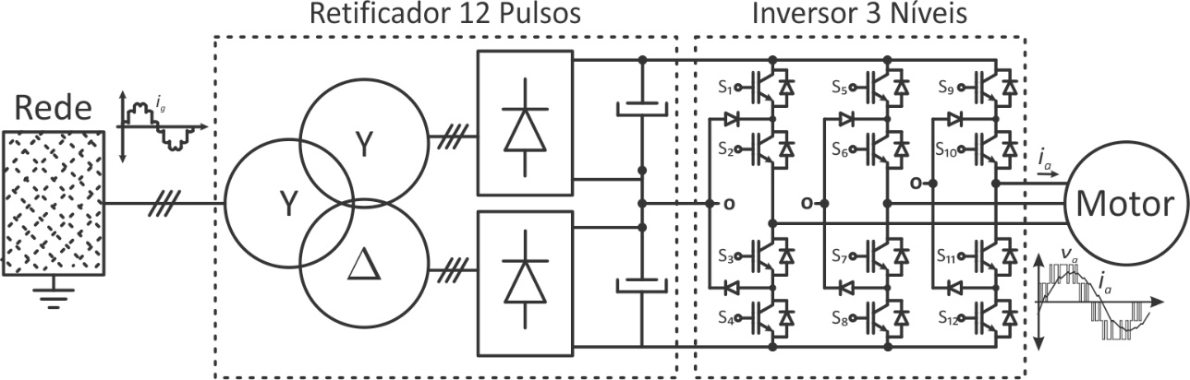

Slide 21
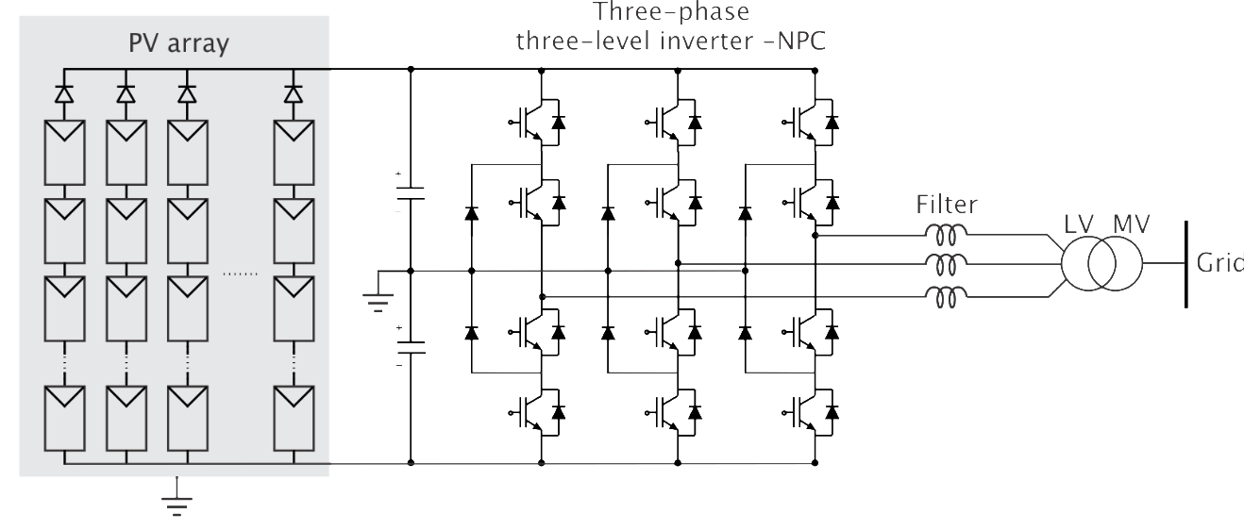

Slide 22
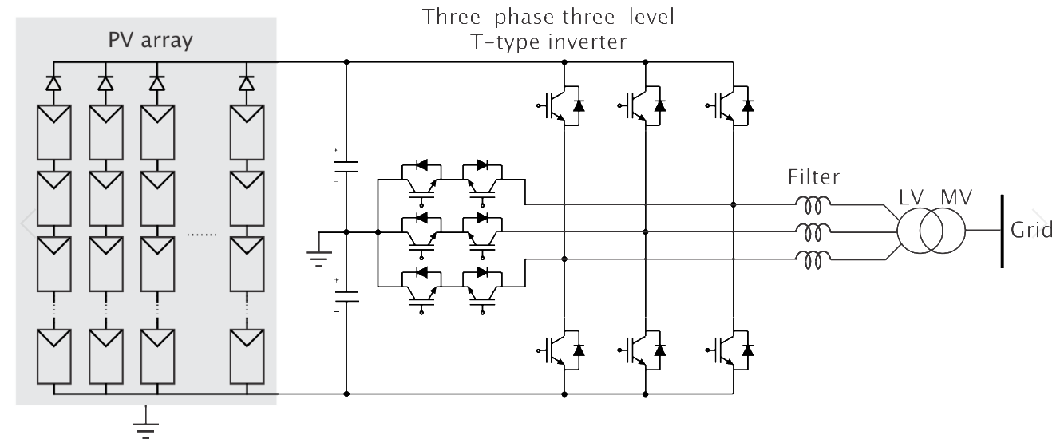

Slide 23
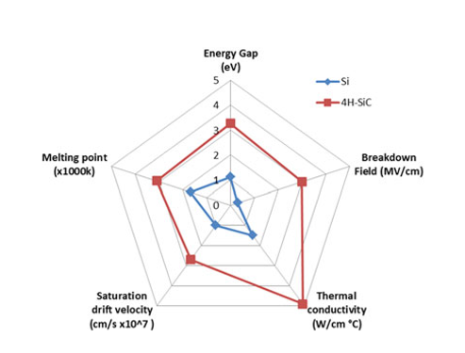
Introduction Power Semiconductor Technologies
Source:Review of Silicon Carbide Power Devices and Their AppicationsIEEE TRANSACTIONS ON INDUSTRIAL ELECTRONICS, VOL. 64, NO. 10, OCTOBER 201

Slide 24
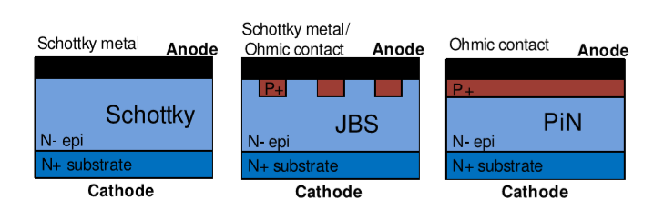
Introduction Power Semiconductor Technologies - Diodes
Source:Review of Silicon Carbide Power Devices and Their AppicationsIEEE TRANSACTIONS ON INDUSTRIAL ELECTRONICS, VOL. 64, NO. 10, OCTOBER 201

Slide 25
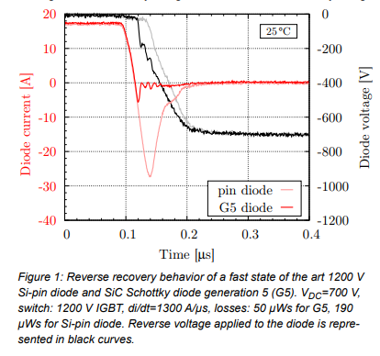
Introduction Power Semiconductor Technologies - Diodes
Si PIN Diodes x SiC Schottky Diodes
Source: Advantages of the 1200 V SiC Schottky Diode with MPS Design. Infineon Technologies AG

Slide 26
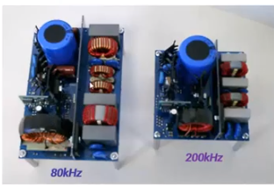
Introduction Power Semiconductor Technologies - Diodes
Si PIN Diodes x SiC Schottky Diodes
Source: http://go.wolfspeed.com

Slide 27
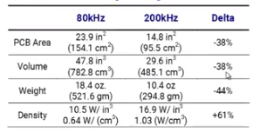
Introduction Power Semiconductor Technologies - Diodes
Si PIN Diodes x SiC Schottky Diodes
Source: http://go.wolfspeed.com

Slide 28
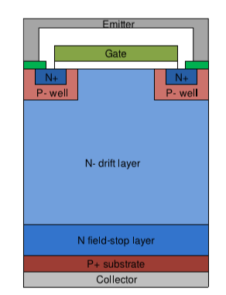
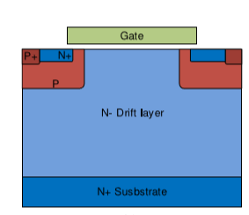
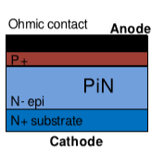
Introduction Power Semiconductor Technologies - Transistors
Si IGBT + PIN Diode x SiC MOSFETS
+
Source:Review of Silicon Carbide Power Devices and Their AppicationsIEEE TRANSACTIONS ON INDUSTRIAL ELECTRONICS, VOL. 64, NO. 10, OCTOBER 201

Slide 29
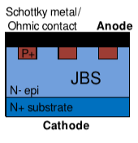
Introduction Power Semiconductor Technologies - Transistors
Si IGBT + SiC JBS Diode x SiC MOSFETS
+
Source:Review of Silicon Carbide Power Devices and Their AppicationsIEEE TRANSACTIONS ON INDUSTRIAL ELECTRONICS, VOL. 64, NO. 10, OCTOBER 201

Slide 30
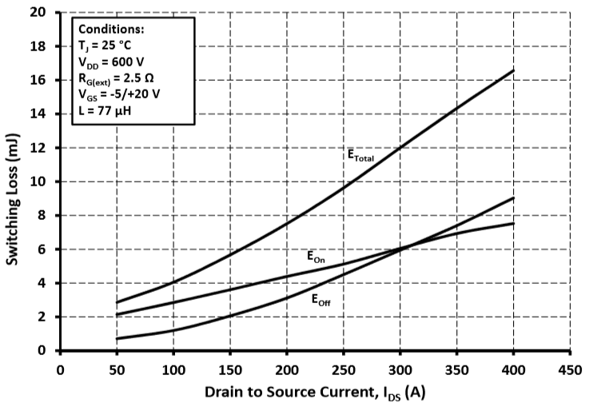
Introduction Power Semiconductor Technologies -- Switching - Losses

Slide 31
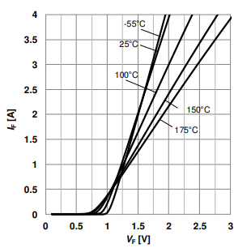
Perdas de Condução IGBT e Diodes
Source: IDK02G65C5 SiC schottky diode Infineon

Slide 32
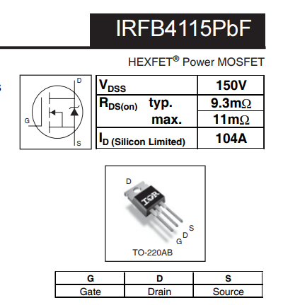
Perdas de Condução MOSFETS

Slide 33
Perdas Comutação
Notes:
As comutações em semicondutores de potência encontrados em conversores estáticos apresentam uma duração pequena se compara com o período de comutação e envolve transporte de carga, elétrons e buracos, nas diferentes camadas do dispositivo. Para o Engenheiro de Eletrônica de potência, a geometria do semicondutor e a concentração de portadores geralmente não são fornecidas pelos fabricantes, mas sim o desempenho em termos de tempos de atraso, energia associadas às comutações ou mesmos modelos não lineares a parâmetros concentrado que reproduzem as corrente e tensões nos terminais dos semicondutores, como o SPICE do inglês ( Simulation Program with Integrated Circuit Emphasis), que possibilitam obter as energias associadas as comutações.
Energia é a taxa com que a potência é transferida para um sistema ou dispositivo. No caso das perdas de comutação em conversores estáticos estamos interessado na potência média calculada em um intervalo de tempo que está associada A energia que será dissipada e causará variações de temperatura nas junções dos semicondutores de potência. Seja a energia em Jaule na foram de calor durantes as comutações de um semicondutor em um intervalo de tempo, então:

Slide 34
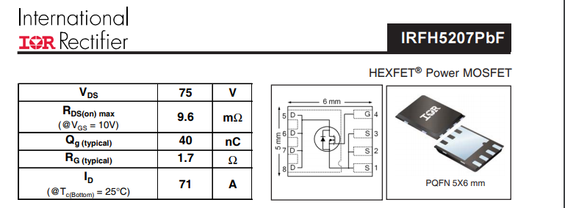

Slide 35
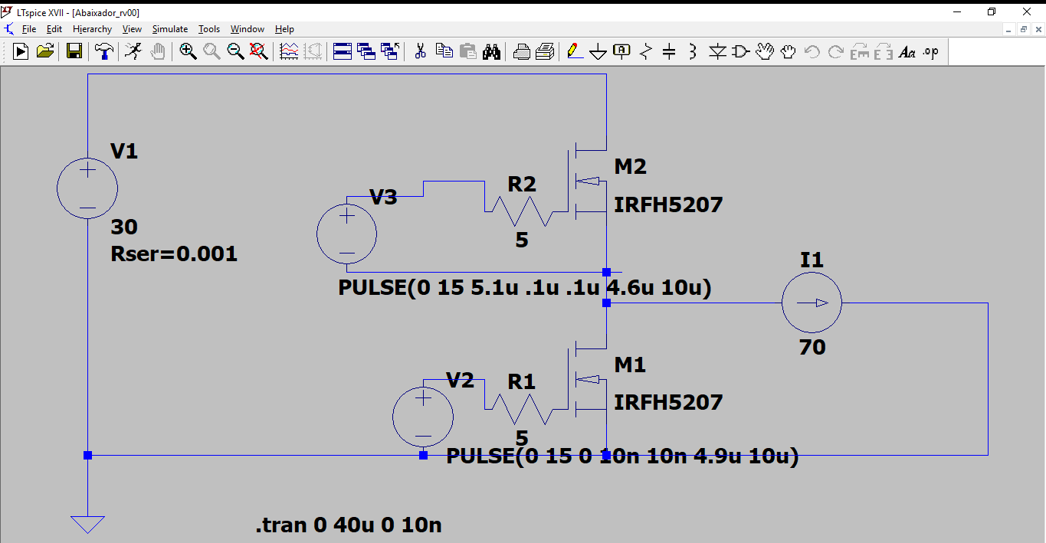

Slide 36
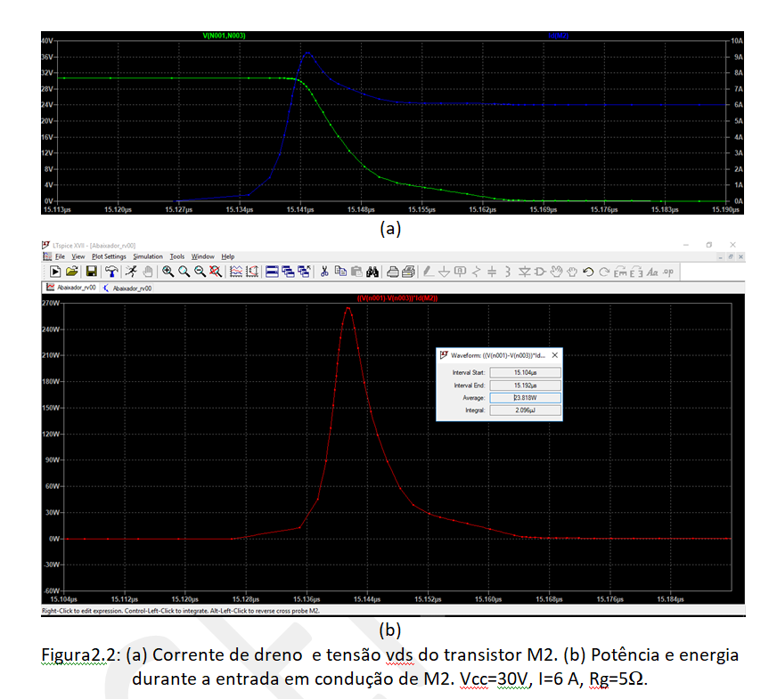

Slide 37
Figura 2.3: Perdas de comutação.

Slide 40
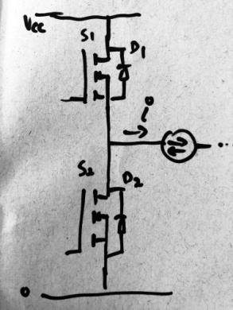
Classificação das Comutações:

Slide 41
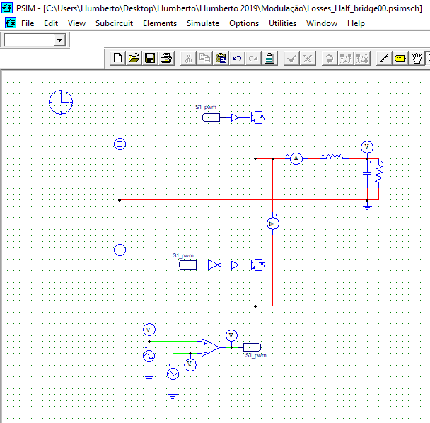
Example

Slide 42
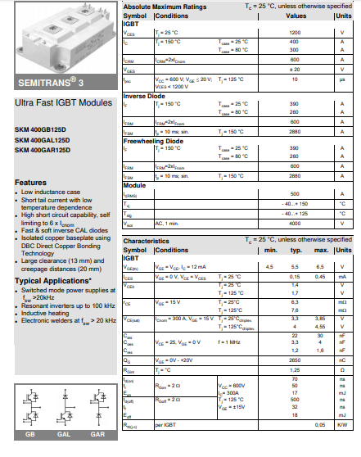
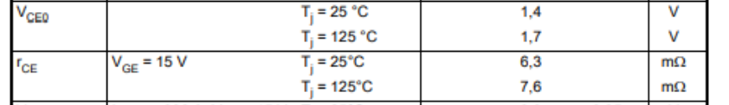
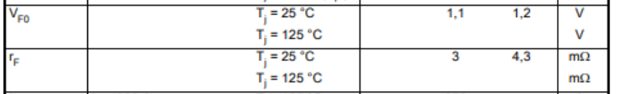
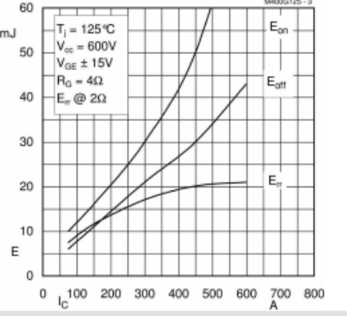

Slide 43
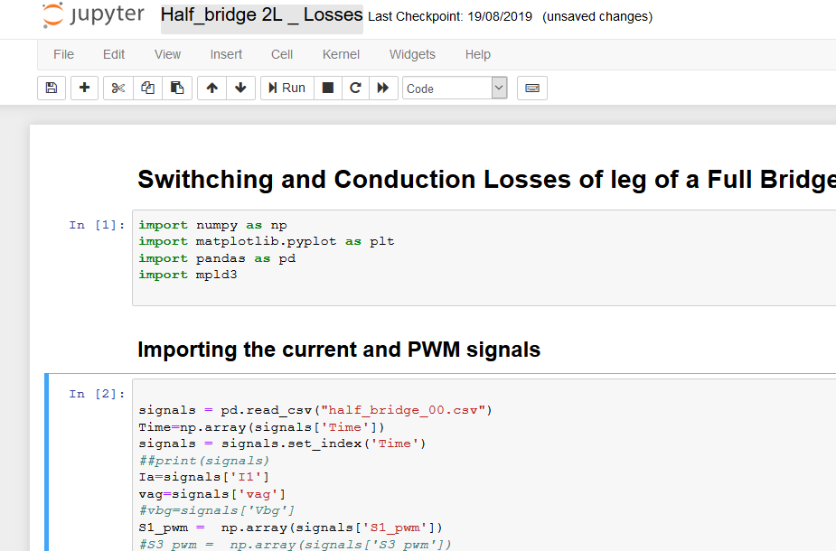

Slide 44
Proposed Exercise
Classify the commutations for a Leg of:
NPC converter
Three level Flying capacitor
T-Type converter

Slide 45
THD and Weighted Total Harmonic Distortion WTHD

Slide 47
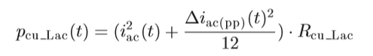
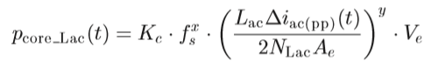
AC inductor Losses
Copper Losses
Core Losses --- Steinmetz equation
IEEE TRANSACTIONS ON POWER ELECTRONICS, VOL. 30, NO. 12, DECEMBER 2015 7299 Dual Active Bridge-Based Battery Charger for Plug-in Hybrid Electric Vehicle With Charging Current Containing Low Frequency Ripple Lingxiao Xue, Student Member, IEEE, Zhiyu Shen, Member, IEEE, Dushan Boroyevich, Fellow, IEEE, Paolo Mattavelli, Fellow, IEEE, and Daniel Diaz
Notes:
he most popular approach is
based on a Finite Element Method “FEM”. In [23] and [24]
excellent results have been presented by the authors.
However, as well known, the FEM approach is very time
consuming particularly in the preparation of models
(lamination mesh, material definition, etc.) and
computational time.

Slide 48
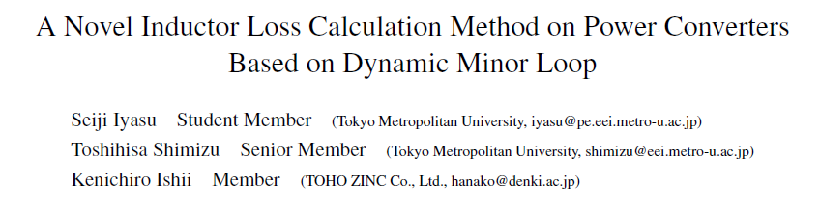
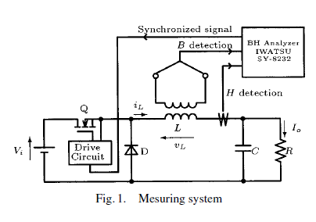
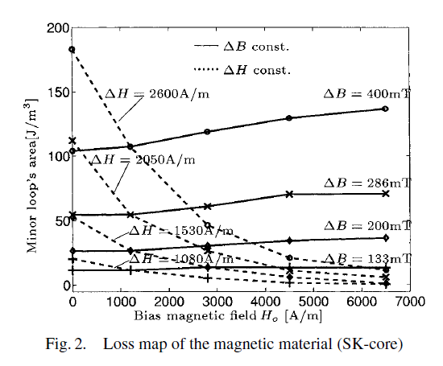

Source:

Slide 49
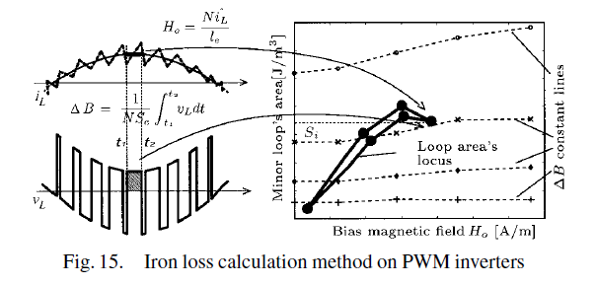
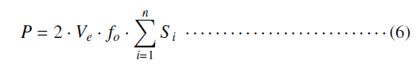
Source:

Slide 50
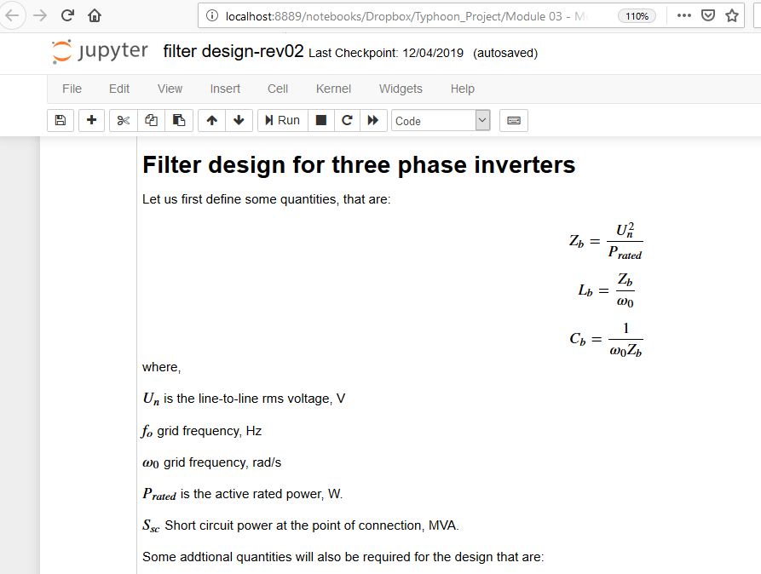
Filter Design

Slide 51
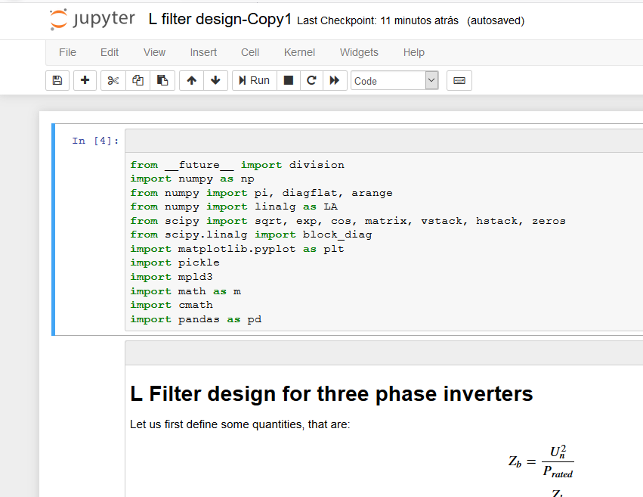
Filter Design

Slide 52
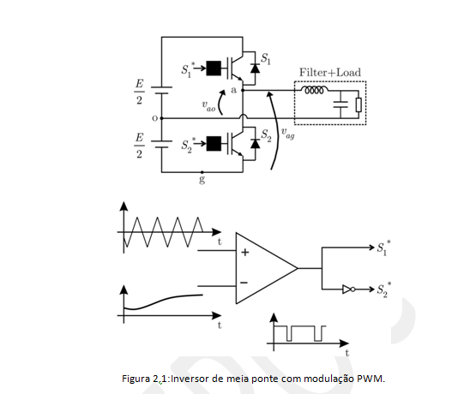
Carrier based PWM

Slide 53
Carrier based PWM

Slide 54
Carrier based PWM

Slide 55
Carrier based PWM

Slide 56
Integral Dupla de Fourier

Slide 57
Integral Dupla de Fourier

Slide 58
Carrier based PWM

Slide 59
Carrier based PWM

Slide 60
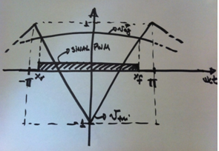
Carrier based PWM

Slide 61
Carrier based PWM

Slide 62
Carrier based PWM

Slide 63
Carrier based PWM

Slide 64
Carrier based PWM

Slide 65
Carrier based PWM

Slide 66
Carrier based PWM
m=n=0

Slide 67
Carrier based PWM
m=n=0

Slide 68
Carrier based PWM
m=n=0

Slide 70
m=0 e n different than zero

Slide 71
m=0 e n different than zero

Slide 72
m=0 e n different than zero

Slide 73
m=0 e n different than zero

Slide 74
m=0 e n different than zero

Slide 76
n=0 e m greater zero

Slide 77
n=0 e m greater zero

Slide 78
n=0 e m greater zero

Slide 79
Jacobi–Anger expansion

Slide 80
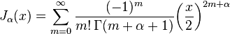
Friedrich Bessel

Slide 81
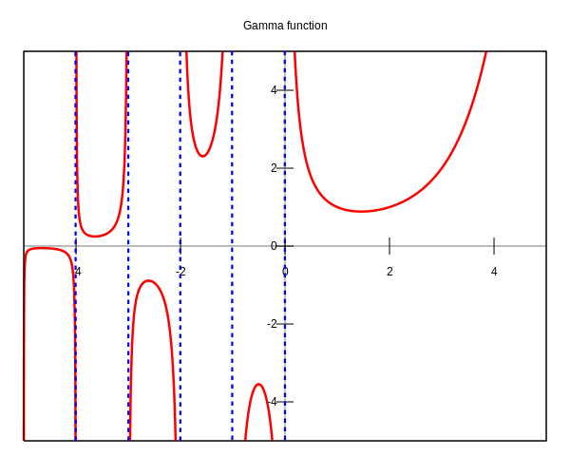
Gamma Function Argument positive integer

Slide 82
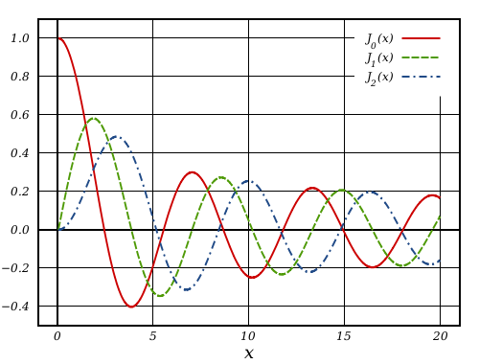
Bessel Functions First Kind

Slide 83
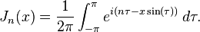
Bessel Functions Properties
−J₁(x) is the derivative of J₀(x)
For an integer n

Slide 84
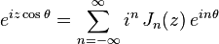
Jacobi – Anger Expansion

Slide 86
Jacobi–Anger expansion

Slide 90
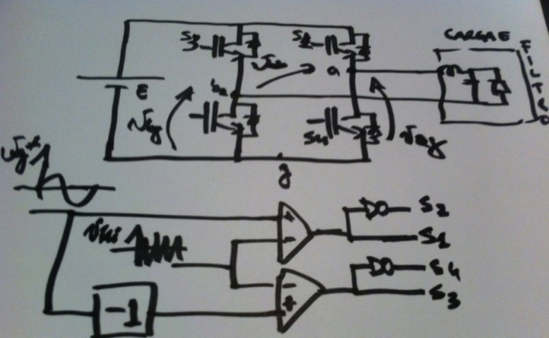
Example: Full Bridge Single Phase Converter

Slide 91
In order to maximize the magnitude of the fundamental of v_{ab}

Slide 92
In order to maximize the magnitude of the fundamental of v_{ab}
To cancel the components at multiples of the carrier frequency let us use the same carrier for the legs a and b , and set

Slide 93
Therefore:
Zero for m and n odd
Zero for m and n even
Zero for (m+n) even

Slide 94
Therefore:
Zero for (m+n) even
Zero for m and n odd
Zero for n even

Slide 95
Therefore:
Zero for (m+n) even
Zero for m and n odd
Zero for n even
Different than zero for m even and n odd

Slide 96
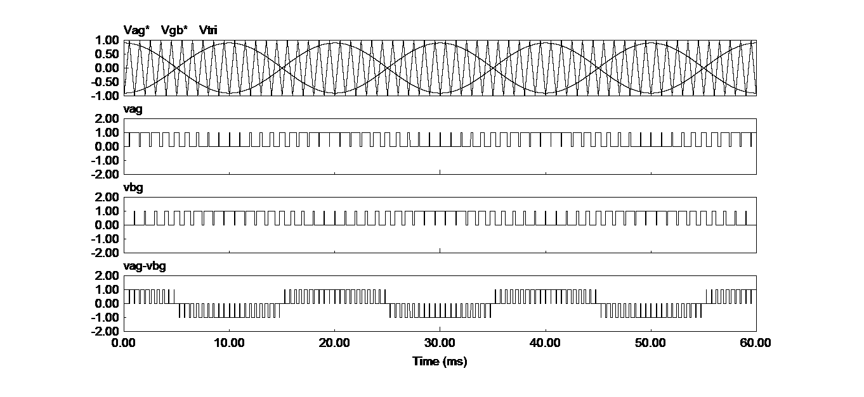

Slide 97
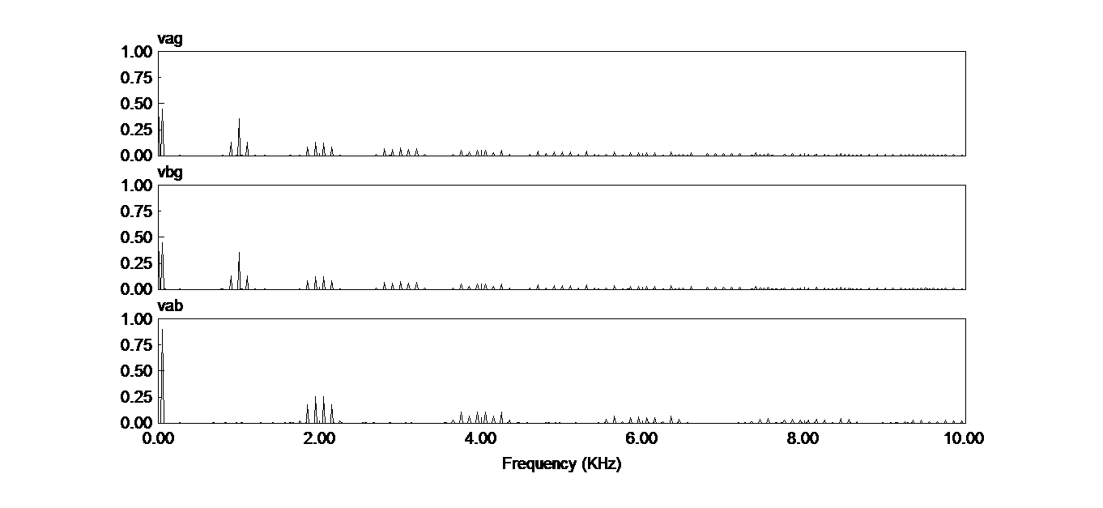

Slide 98
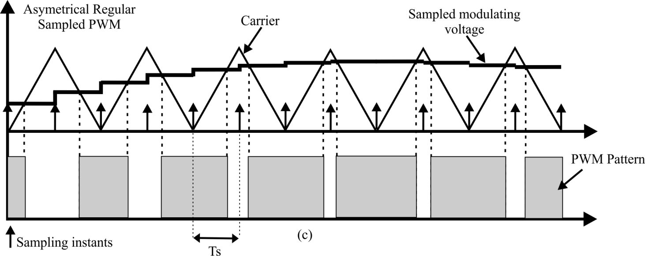
Asymmetrical Regular Sampled PWM
Sampling
instants
Sampled Modulating
Signal
t
t
Sampling
period

Slide 99
Spectrum of a Asymmetrical Regular Sampled PWM
Reference: Opportunities for Harmonic Cancellation with Carrier-Based PWM for Two-Level and Multilevel Cascaded Inverters
Donald Grahame Holmes, Member, IEEE, and Brendan P. McGrathIEEE TRANSACTIONS ON INDUSTRY APPLICATIONS, VOL. 37, NO. 2, MARCH/APRIL 2001

Slide 100
Spectrum of a Asymmetrical Regular Sampled PWM
It is close to ma for wc > 20wo
Reference: Opportunities for Harmonic Cancellation with Carrier-Based PWM for Two-Level and Multilevel Cascaded Inverters
Donald Grahame Holmes, Member, IEEE, and Brendan P. McGrathIEEE TRANSACTIONS ON INDUSTRY APPLICATIONS, VOL. 37, NO. 2, MARCH/APRIL 2001

Slide 101
Spectrum of a Asymmetrical Regular Sampled PWM
They are not affected by the sampling

Slide 102
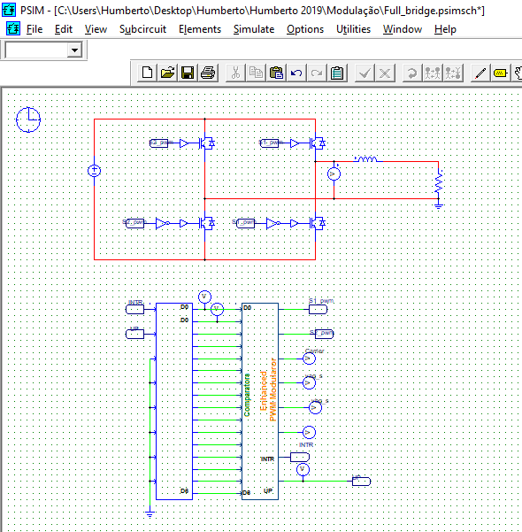

Slide 103
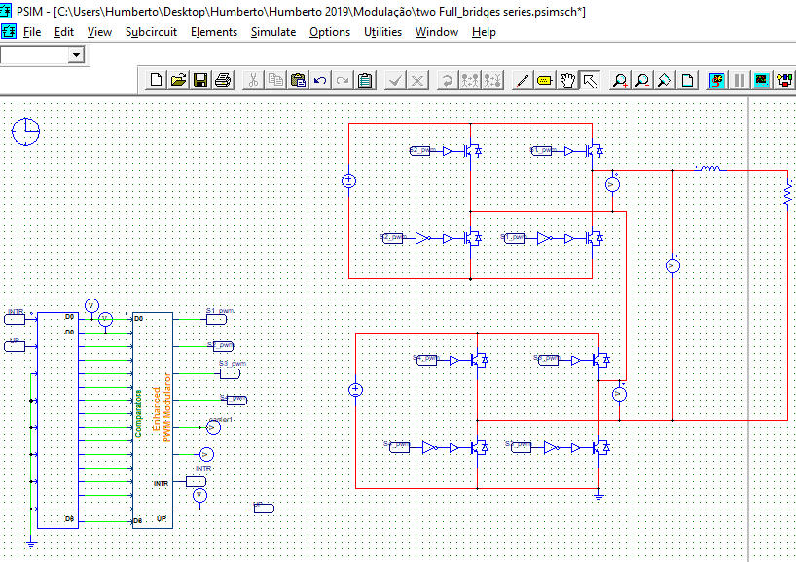

Slide 106


Slide 107


Slide 108


Slide 109


Slide 110


Slide 111

Phase Disposition PWM

Slide 112

Phase Disposition PWM
Espectro harmônico da tensão v_{ag} para conversor de quatro níveis com diodo de grampeamento, modulação PD.

Slide 113

APOD PWM

Slide 114

APOD PWM
Espectro harmônico da tensão v_{ag} para conversor de quatro níveis com diodo de grampeamento, modulação APOD.

Slide 115

APOD PWM

Slide 116

PD PWM

Slide 117
Summary
Closed form for the spectrum of PWM signal
Explored the cancelation of harmonics in single and three phase converter
The PD and APOD are alternatives for modulation of multilevel converter

Slide 118

Geometric Approach
Source: Ryan, M.J.; Lorenz, R.D.; De Doncker, R.W., "Modeling of multileg sine-wave inverters: a geometric approach," Industrial Electronics, IEEE Transactions on , vol.46, no.6, pp.1183,1191, Dec 1999.

Slide 119


Slide 120


Slide 121


Slide 122


Slide 123


Slide 124


Slide 125

Geometric Approach

Slide 128
Set all possible v_{o}

Slide 129
Set all possible v_{o}

Slide 130
Set all possible v_{o}

Slide 131

Set all possible v_{o}

Slide 132
Candidates for the implementation of v_{o}

Slide 133


Slide 134


Slide 135


Slide 136

Implementation
v_{ab}

Slide 141
How to define v_{o}?

Slide 147
Example

Slide 148


Slide 150


Slide 151


Slide 152

Control of three-phase PWM converter from the □ coordinates
Inverter ac side equivalent circuit

Slide 153
From the KVL Inverter ac side equivalent circuit
From the KCL Inverter ac side equivalent circuit

Slide 156
Clarke Transformation
“There is no demand for women engineers, as such, as there are for women doctors; but there's always a demand for anyone who can do a good piece of work”
Edith Clarke

Slide 160


Slide 161
Geometric Interpretation
e¹
e²
e³

Slide 162
For operation in the linear range

Slide 163
For operation in the linear range Normalized voltages

Slide 167


Slide 168


Slide 169


Slide 170


Slide 171

Closed Loop Operation Grid-Tied Converter

Slide 172


Slide 173


Slide 174

Modulação Geométrica
Vamos considerar um inversor trifásico quatro pernas a quatro fios
E
E
Carga Trifásica
com quatro fios
Notes:
O fios

Slide 175
Geometric Approach - Four Leg For wire three phase converter
a
E
b
E
c
n
Three-phase four wire load
g
Notes:
O fios

Slide 176
Geometric Approach - Four Leg For wire three phase converter
a
E
b
E
c
n
g
Notes:
O fios

Slide 177
Geometric Approach - Four Leg For wire three phase converter
a
E
b
E
c
n
g
This row has been selected to make the matrix non singular
Notes:
O fios

Slide 180
When operating in the linear region

Slide 181
or

Slide 182
Then,
as a result,

Slide 183
Possible vo
(1)

Slide 184


Slide 187


Implementation
v_{an}
v_{bn}
v_{cn}
eq. (1)

Slide 188
Modulating signals and carrier
v_{ag}*
v_{bg}*
v_{cg}*
v_{ng}*
Angulo

Slide 189
Leg voltages
v_{ng}
v_{ag}
v_{cg}
v_{bg}
time
Number of commutations
leg n: 50
leg a,b,c: 50

Slide 190
Converter output voltages
v_{an}
v_{bn}
v_{cn}
Tempo
Notes:
Natural sampling three phase 4 pernas

Slide 191
Spectrum of the output voltages
DF1=16.38/1000
DF2=6.48/10000
DF3=5.9/100000
Amplitude Normalizada da Harmônica
Harmonic order

Slide 193
Modulating Signals and carrier
v_{ag}*
v_{bg}*
v_{cg}*
v_{ng}*
Angulo

Slide 194
Leg voltages
v_{ng}
v_{ag}
v_{cg}
v_{bg}
Number of commutation
Leg n: 50
Leg a,b,c: 34
time

Slide 195
Tensões de fase de saída do conversor
v_{an}
v_{bn}
v_{cn}
Tempo

Slide 196
Espectro da Tensões de Fase de Saída
v_{an}
DF1=17.35/1000
DF2=7.47/10000
DF3=17.15/100000
Amplitude Normalizada da Harmônica
Ordem da Harmônica

Slide 197

Optimum Geometric Carrier-Based Modulation for NPC and T-Type Inverters
Source: Optimum Geometric Carrier-Based Modulation for NPC and T-Type Inverters
Gleisson Balen, Jorge Massing, Rodrigo Vieira, Fernanda Carnielutti, Humberto Pinheiro. IECON 2019.

Slide 198

Phase Disposition Modulation - PD

Slide 199

PD with one carrier and two modulating signals

Slide 200

The line to line PWM signals result in the nearest levels

Slide 201

Low frequency current harmonics can be present in the neutral point

Slide 202


Slide 203


Slide 210


Slide 211


Slide 212


Slide 213

At each sampling instant :
The converter phase voltage to be synthesized are know,
The converter ac side currents can be measured,
Then following function describes how the v_{o} impacts the current at the neutral point.

Slide 214

The upper and lower values for v_{o} can be found to ensure operation in the linear region, that is:

Slide 215

The problem of finding v_{o} that results in the desired, or closest to the desired, current flowing into the dc-bus central point can be solved from the minimization of the following function, at each sampling instant.

Slide 216


Slide 217

Plot of

Slide 218

Plot of

Slide 219

f(v_{o},.) depends on the ma, PF, and I_{o_ref} and it is non-convex at some operating points.

Slide 220

f(v_{o},.) can be computed in n points, say n=10, within the interval v_{omax} and v_{omin} and the value v_{o} that results in the smallest value of f(v_{o},.) is implemented.

Slide 221


Slide 222

Conventional selection of v_{o}
ma=0.7
PF=0.66

Slide 223

Optimum selection of v_{o}
ma=0.7
PF=0.66

Slide 224

Conventional selection of v_{o}
ma=0.9
PF=0.66

Slide 225

Optimum selection of v_{o}
ma=0.9
PF=0.66

Slide 226


Slide 227

Optimum Geometric Carrier-Based Modulation for NPC and T-Type Inverters

Slide 228


Slide 229


Slide 230


Slide 231


Slide 232


Slide 233


Slide 234

Optimum Geometric Carrier-Based Modulation for NPC and T-Type Inverters

Slide 235

Making the neutral point current equal to zero independent of the modulation index and PF

Slide 236
Decomposed modulating signals

Slide 237
For operation in the linear region
To avoid that the inverter voltage become depend on the sign of the ac currents

Slide 238


Slide 239


Slide 240
For operation in the linear region
To avoid that the inverter voltages become depend on the sign of the ac currents

Slide 241

The current through the neutral point as a function of the decomposed modulating signals can be expressed as:
T_{s}

Slide 243
The total current through the neutral point as a function of the decomposed modulating signals can be expressed as:
By making,
results:
.

Slide 246
How to select the auxiliary variable v_{m}?

Slide 248


Slide 249


Slide 250

m_{a}=0.9;v_{o}=0.5(v_{omax}+v_{omin});v_{m}=r_{max}

Slide 251

m_{a}=0.9;v_{o}=0.5(v_{omax}+v_{omin});v_{m}=r_{min}

Slide 252

m_{a}=0.9;v_{o}=0.5(v_{omax}+v_{omin});v_{m}=r_{max}, PF=0.7.

Slide 253


Slide 254


Slide 255
Control of the dc bus mid point voltage
During the dashed intervals it is possible to add offsets to the decomposed modulating signals to balance the dc voltage

Slide 256
Control of the dc bus mid point voltage
Control for the balance of the dc bus voltages

Slide 257
Control of the dc bus mid point voltage
Control for the balance of the dc bus voltages
Note that

Slide 258
Control of the dc bus mid point voltage
Control for the balance of the dc bus voltages
Lets define

Slide 259
Control of the dc bus mid point voltage
As a result
If then

Slide 260


Slide 261


Slide 262


Slide 263
Dead-band Control

Slide 264
Four Level diode clamped converter

Slide 265


Slide 267


Slide 272
a₂=1, a₅=1, a₈=1, b₁=1, b₄=1, b₇=1, others equal to zero

Slide 280



Slide 281
Comments regarding the Carried Based Geometric Approach for Diode Clamped Converters
The dc balance control is guaranteed and does not depend on the load power factor
The minimization of the THD is ensure whenever possible
Elimination of low order harmonics on the DC bus can be achieved when operating with high power factor
The implementation is straightforward
Notes:
2288 IEEE TRANSACTIONS ON INDUSTRIAL ELECTRONICS, VOL. 54, NO. 4, AUGUST 2007
Fast-Processing Modulation Strategy for the
Neutral-Point-Clamped Converter With Total
Elimination of Low-Frequency Voltage
Oscillations in the Neutral Point
Josep Pou, Member, IEEE, Jordi Zaragoza, Pedro Rodríguez, Member, IEEE, Salvador Ceballos,
Vicenç M. Sala, Rolando P. Burgos, Member, IEEE, and Dushan Boroyevich, Fellow, IEEE

Slide 282

Interleaved Three-phase Converter
MODULAÇÃO DESCONTÍNUA COM PORTADORA PARA INVERSORES COM PERNAS EM PARALELO
André Nicolini¹, Antônio Ricciotti², Fernanda Carnielutti¹, Humberto Pinheiro¹
Eletrôn. Potên., Campo Grande, v. 21, n.4, p. 266-273, out./dez. 2016

Slide 283



Coupled inductor

Slide 284



Coupled inductor

Slide 285
Coupled inductor

Slide 286
Modulation for a Leg
From the KVL in the circuit
By assuming a strong coupling between the coupled inductor windings
Then

Slide 287


Slide 288
In a matrix form:
For operation in the linear region:
or

Slide 291


Slide 292


Slide 293
It is possible to phase-shift the carriers of leg a1 and leg a2 by 180 degrees to cancel out the harmonics around the carrier frequency in the voltage v_{ag_eq}.

Slide 294


Slide 295


Slide 296


Slide 297


Slide 298
Closed loop control of the circulating current

Slide 299


Slide 300


Slide 301

Is it possible to reduce the THD of the inverter line-to-line voltages?

Slide 302

Discontinuous Modulation for Interleaved Three-Phase converters

Slide 303


Slide 304


Slide 305


Slide 306


Slide 307


Slide 308


Slide 309

Conduction State

Slide 312

State machine

Slide 313


Discontinuous Modulation for Interleaved Three-Phase converters

Slide 314

State Machine

Slide 315

Circulating Current

Slide 316
Control of the Circulating Current
Let us introduce an auxiliary variable to make it possible:
- To control the average value of v_{ca} in two sample period.
- do no affect the average value of the v_{ag_eq} in two sample periods.

Slide 317
Let us assume that:
and
Then
Now, an auxiliary variable is introduced to make it possible to control the circulating current, that is

Slide 318
Therefore:
In the next sampling instant
And the auxiliary variable is add to vag1, that is
as a result

Slide 319
The average value of the equivalent leg voltage and the voltage that is used to control the circulating current over two sampling periods are
If is kept small, then:

Slide 320
Similarly, let us assume that:
and
Then
Now, the auxiliary variable is introduced to make it possible to control the circulating current, that is

Slide 321
Therefore:
In the next sampling instant
And the auxiliary variable is subtracted from v_{ag2}, that is
as a result

Slide 322
The average value of the equivalent leg voltage and the voltage that is used to control the circulating current over two sampling periods are
Again, if is kept small, then:

Slide 323


Slide 324


Slide 325


Slide 326


Slide 327


Slide 328

Geometric Approach
Interleaved Inverter
Three-phase Grid Connected inverter with three parallel legs

Slide 329
Geometric Approach
Interleaved Inverter
Modulation goals
To allow the current sharing control;
To reduce the THD of the output quantities;
To distribute the commutations among the power switches;
To mitigate the circulating currents;
To have a simple implementation.

Slide 330

Discontinuous Modulation Approach
Single-phase Equivalent Circuits of AC side
Notes:
A cada período de excitação a fonte VE transfere energia para o campo da fase correspondente (chaves fechadas). Quando as chaves das são abertas, essa energia mais a parcela proveniente da conversão eletromecânica é transferida para a carga.

Slide 331

Discontinuous Modulation Approach
Single-phase Equivalent Circuits of AC side
Notes:
A cada período de excitação a fonte VE transfere energia para o campo da fase correspondente (chaves fechadas). Quando as chaves das são abertas, essa energia mais a parcela proveniente da conversão eletromecânica é transferida para a carga.

Slide 332
Discontinuous Modulation Approach
Equivalent voltages:

Slide 333
Discontinuous Modulation Approach
Equivalent voltages:
Reorganizing:

Slide 334
Discontinuous Modulation Approach

Slide 335
Discontinuous Modulation Approach
For operation in the linear region

Slide 336
Discontinuous Modulation Approach
For operation in the linear region
where

Slide 337

Discontinuous Modulation Approach

Slide 338
Discontinuous Modulation Approach
v_{a_eq}=2/3
v_{a_eq}=2/3

Slide 339
Discontinuous Modulation Approach
v_{a_eq}=1/3
v_{a_eq}=1/3
v_{a_eq}=1/3

Slide 340
Discontinuous Modulation Approach
v_{a_eq}=1/3
v_{a_eq}=2/3
v_{a_eq}=2/3
v_{a_eq}=2/3
v_{a_eq}=1

Slide 341
Discontinuous Modulation Approach
For operation in the linear region in sector 1 of the plane v_{c1} x v_{c2}
Is equivalent

Slide 342
Discontinuous Modulation Approach
For operation in the linear region in sector 1 of the plane v_{c1} x v_{c2}
Is equivalent

Slide 343
Spectrum of the voltage v_{ag}

Slide 344
Discontinuous Modulation Approach

Slide 345
Discontinuous Modulation Approach

Slide 346
Discontinuous Modulation Approach

Slide 347

Discontinuous Modulation Approach

Slide 348

Discontinuous Modulation Approach

Slide 349

Discontinuous Modulation Approach

Slide 350


Discontinuous Modulation Approach
State
Sector
Switching State
Negative
Positive
Negative
Positive

Slide 351

Discontinuous Modulation Approach

Slide 352

Trajectory of the Circulating Currents Vector

Slide 353

Trajectory of the Circulating Currents Vector

Slide 354

Trajectory of the Circulating Currents Vector
Near

Slide 355

Trajectory of the Circulating Currents Vector

Slide 356

Trajectory of the Circulating Currents Vector
Transition between regions of v_{a_eq}

Slide 357

Main Waveforms: Transitions between regions

Slide 358

Main Waveforms

Slide 359

Circulating Current Control
Control block diagram for the phase a of a three-phase inverter with three parallel legs.

Slide 360
Summary
Multilevel equivalent output line-to-line voltages with reduced harmonic distortion;
It is possible to control the circulating currents to values close to zero;
The PWM pulses are evenly distributed among the parallel legs.
There is no transient on the circulating currents
The proposed modulation can be extended to inverters with more legs per phase;
The approach is simple to be implemented;

Slide 361

Double Commutation
Analysis of sectors transition: Sector 1 to Sector 2 of the proposed modulation.

Slide 362

Three-Phase Flying Capacitor Converter
MODULAÇÃO DESCONTÍNUA PARA CONVERSOR DE CAPACITOR FLUTUANTE COM CONTROLE DE TENSÃO DOS CAPACITORES Mauricio M. da Silva, Ademir Toebe, Humberto Pinheiro Universidade Federal de Santa Maria – UFSM, Santa Maria – RS, Brasil
Eletrôn. Potên., Joinville, v. 23, n. 4, p. 414-423, out./dez. 2018

Slide 363


Slide 364


Slide 365


Slide 366
. Since
For both cases
let us define
.

Slide 367


Slide 368
In a matrix form:
For operation in the linear region:

Slide 370


Slide 371


Slide 372



Slide 373


Slide 374


Slide 375

Generalized Carrier-Based Modulation Strategy for Cascaded Multilevel Converters Operating Under Fault Conditions
Generalized Carrier-Based Modulation Strategy for Cascaded Multilevel Converters Operating Under Fault Conditions Fernanda Carnielutti, Humberto Pinheiro, Member, IEEE, and Cassiano Rech, Member, IEEE
IEEE TRANSACTIONS ON INDUSTRIAL ELECTRONICS, VOL. 59, NO. 2, FEBRUARY 2012

Slide 376


Slide 377


Slide 378


Slide 379


Slide 380


Slide 381


Slide 382


Slide 383


Slide 384


Slide 385


Slide 386




Slide 387


Slide 388


Slide 389


Slide 390


Slide 391


Slide 392


Slide 393
Summary on the Geometric Approach
It is carrier based modulation
It make it possible to explorer the entire voltage synthesis capability.
The design procedure is straightforward starting form the inequalities that ensure proper operation and equalities that associate the leg voltages and output quantities
It also make it possible to control the converter internal variable
In the interleaved converter an additional commutation can reduce the peak of flux in the coupled inductor.
The implementation usually simpler than other methods

Slide 394
Space Vector Modulation

Slide 395

Space Vector Modulation
General Analysis of Three-Phase Inverters
KALMAN R. JARDAN,
S. B. DEWAN, MEMBER, IEEE,
GORDON R. SLEMON, SENIOR MEMBER, IEEE
IEEE TRANSACTIONS ON INDUSTRY AND GENERAL APPLICATIONS, 1969.
Notes:
APPLICATIONS of the method of alpha, beta, and zero components to the determination of phase currents and voltages of fundamental frequency in unbalanced 3-phase power systems have DAMPING AND RESONANCE IN POLYPHASB GERATORS, R. Willheim 1929.
IEEE TRANSACTIONS ON INDUSTRY AND GENERAL APPLICATIONS, VOL. IGA-5, NO. 6, NOVEMBER/DECEMBER 1969.
General Analysis of Three-Phase Inverters
KALMAN R. JARDAN, S. B. DEWAN, MEMBER, IEEE, AND
GORDON R. SLEMON, SENIOR MEMBER, IEEE
Power Semiconductor Circuits [Shashi B. Dewan, Alan Straughen] on Amazon.com. *FREE* ...Author interviews, book reviews, editors picks, and more
AIEE TRANSACTIONS (American Institute of Electrical Engineers )
Determination of Instantaneous Currents and Voltages by Means of Alpha, Beta, and Zero Components
IEEE TRANSACTIONS ON INDUSTRY AND GENERAL APPLICATIONS, VOL. IGA-5, NO. 6, NOVEMBER/DECEMBER 1969
General Analysis of Three-Phase Inverters
KALMAN R. JARDAN, S. B. DEWAN, MEMBER, IEEE, AND
GORDON R. SLEMON, SENIOR MEMBER, IEEE

Slide 396
Space Vector Modulation
The modulation is developed in the output voltage space
It make it possible to explorer the entire converter voltage syntheses capability
It breaks the problem into sectors
Usually predefined switching sequences are selected off-line each sector
Notes:
AIEE TRANSACTIONS (American Institute of Electrical Engineers )
Determination of Instantaneous Currents and Voltages by Means of Alpha, Beta, and Zero Components
IEEE TRANSACTIONS ON INDUSTRY AND GENERAL APPLICATIONS, VOL. IGA-5, NO. 6, NOVEMBER/DECEMBER 1969
General Analysis of Three-Phase Inverters
KALMAN R. JARDAN, S. B. DEWAN, MEMBER, IEEE, AND
GORDON R. SLEMON, SENIOR MEMBER, IEEE

Slide 397
Space Vector Modulation
Definition of all possible switching combinations
Mapping all switching vectors into the output voltage space
Definition of the sector and of an algorithm for sector identification
Determination of the vectors dwell times
Definition of a switching sequence

Slide 398
SVM - Three Phase NPC converter

Slide 399
SVM - Three Phase NPC converter

Slide 400
SVM - Three Phase NPC converter
2
1
2
1
0
1
2
1
2
Line-to-Line Switching Vectors in Alpha-Beta Coordinates

Slide 401
SVM - Three Phase NPC converter
v⁰
+++
000
---
Phase Voltage Switching Vectors

Slide 402

Space Vector Modulation

Slide 403

Space Vector Modulation

Slide 404


Slide 405

Space Vector Diagram

Slide 406


Dwell times

Slide 407

Space Vector Diagram
Sector

Slide 408

Space Vector Diagram
Sector

Slide 409
Virtual Vector

Slide 410


Slide 411


Slide 412


Slide 413
Summary SVM
It make it possible to explorer the entire converter capabilities
The selection of Switching Sequences still a challenge for multilevel converters
The development and implementation may requires a dedicated hardware

Slide 414
MODULAÇÃO SPACE VECTOR PARA O CONTROLE DA TENSÃO DO
PONTO CENTRAL DO DIVISOR CAPACITIVO DO NPC
Prof. Humberto Pinheiro, Ph.D.

Slide 415

Modulação Space Vector para o Conversor NPC
Vamos considerar um conversor NPC

Slide 416

Space Vector para o NPC
v_{bg}
v_{ag}

Slide 417

Space Vector para o NPC
v_{bg}
v_{ag}

Slide 418


Space Vector para o NPC
v_{bg}
v_{ag}

Slide 419

SV para o NPC
v_{bg}
v_{ag}

Slide 420

SV para o NPC
v_{bg}
[0 1]^{T}
v_{ag}
0
[1 0] ^{T}

Slide 421

SV para o NPC

Slide 422


Os três vetores mais próximos
j-ésimo conjunto de três vetores distintos

Slide 423



Slide 424

SV para o NPC
Vetor
e¹ e²

Slide 425


Io=0 N3V no NPC
v_{bg}
E
[0 1]^{T}
E
vag
[1 0] ^{T}

Slide 426

Io=0 N3V no NPC

Slide 427

Io=0 N3V no NPC

Slide 428

Io=0 N3V no NPC

Slide 429

Io=0 N3V no NPC

Slide 430


SV para NPC
E
[0 1]^{T}
E
[1 0] ^{T}

Slide 431


SV para NPC

Slide 432


Slide 433
SV para o NPC
Vetor
e¹ e²

Slide 434


Slide 435



Slide 436



Slide 437



Slide 438



Slide 439





Controle da Tensão do Divisor Capacitivo

Slide 440

Controle da Tensão do Divisor Capacitivo

Slide 441

Seqüência de Comutação
E
v_{o}
[1 1]^{T}
E
[0.5 -0.5]^{T}

Slide 442

Seqüência de Comutação

Slide 443

PWM Amostrado Simétrico

Slide 444

SVM Hibrida

Slide 445


